Slide 1
Data Analysis Assessment
A look into EG’s Social Media data
Siddhant Thakur
May 26th, 2023

Slide 2
Agenda
Data
General
Cleaning
Outliers
Questions on Engagement Rate
Typical Reach
Day and Time of Posting
Game Titles
Media Types
Campaigns
Posting Strategy & Suggestions

Slide 3
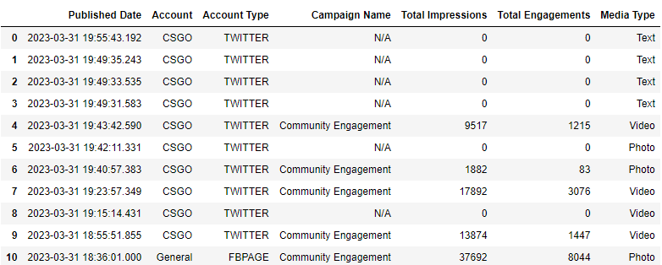
Data - General
3479 rows with 966 rows having 0 Total Engagement.
Contains Impression and Engagement statistics for posts made by different EG accounts on different platforms.
Also contains the date & time as well as the type of media associated with the post.

Slide 4
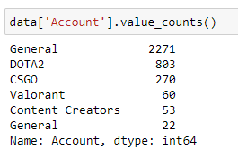

Data - Cleaning
No NaN values present.
‘Account’ column had ‘General’ and ‘General ‘ with ‘LINKEDIN_COMPANY’ as the ‘Account Type’ under the first value.
Solution - Combined together into one ‘General’.
Calculated Engagement Rate using the formula given on the right.

Slide 5
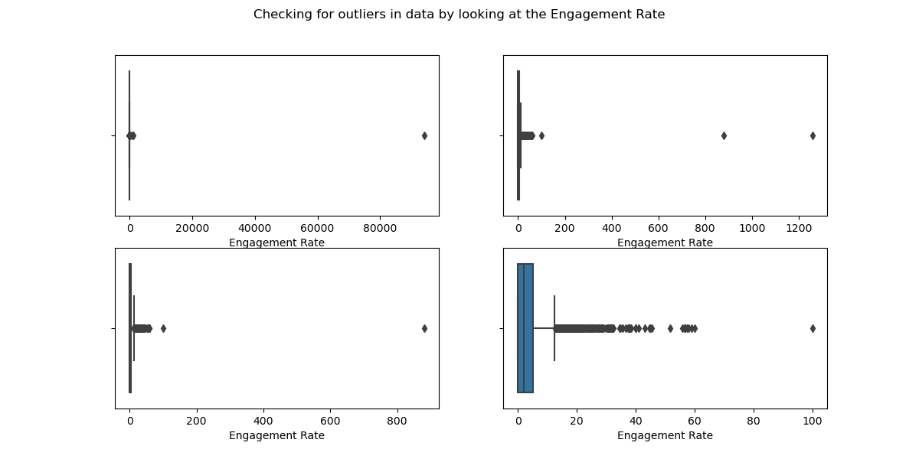
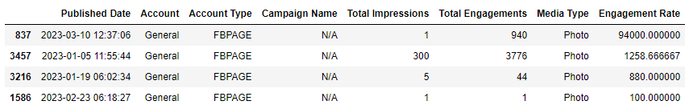
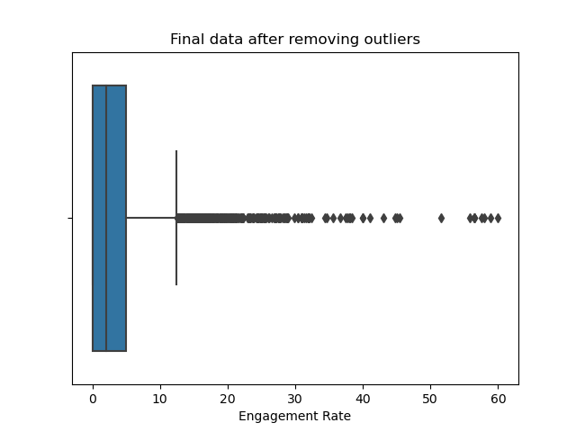
Data - Outliers
4 outliers present in the data with Engagement Rate more than 100%, assumed to be edge cases.
Solution - Removed as data was being skewed.

Slide 6
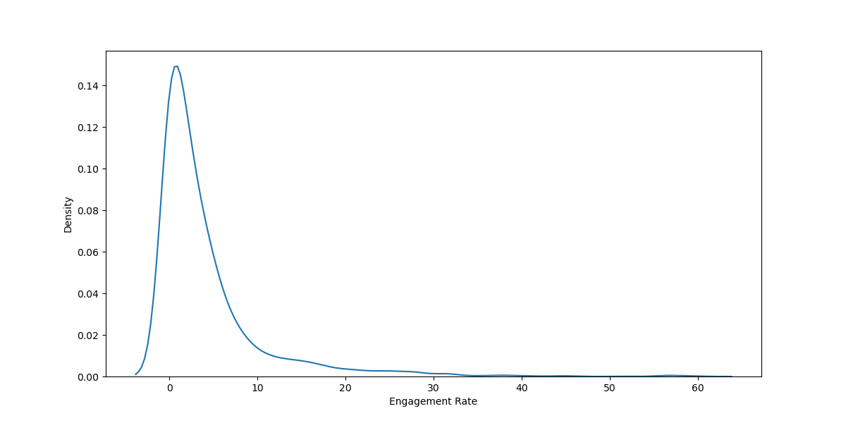
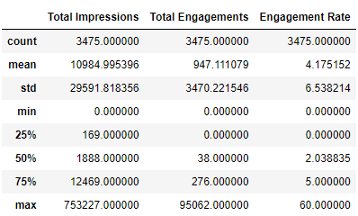
Questions - Typical Reach
What is the typical engagement rate we can expect?
On average we see an engagement rate of 4.175% with a standard deviation of 6.538.
What’s the likelihood that we can achieve a 15% engagement rate?
Assuming normal distribution, the probability of achieving an engagement rate of 15% or more will be approximately 4.85% using z-score.
Since the distribution is skewed to the right, the probability of achieving an engagement rate of at least 15% shifts to 6.38 by using cumulative histogram.

Slide 7
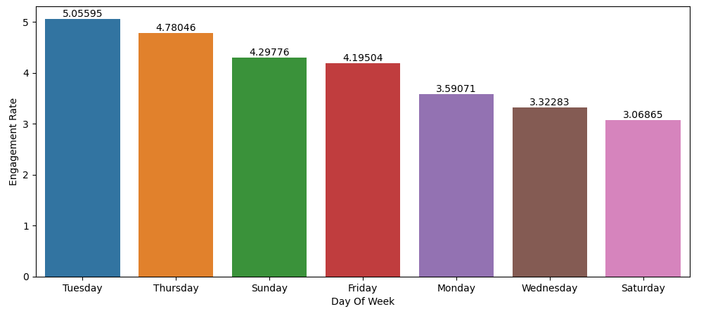
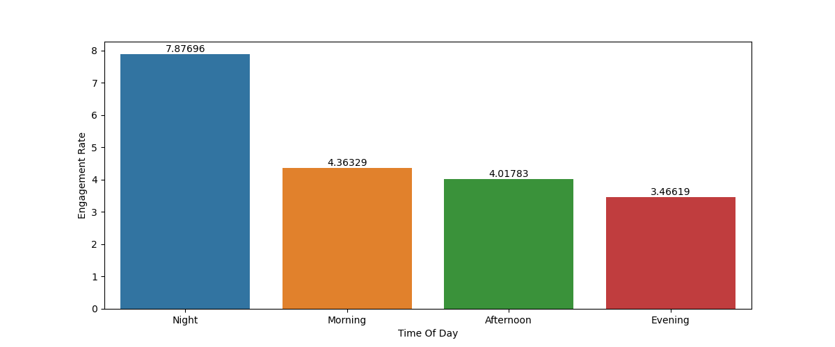
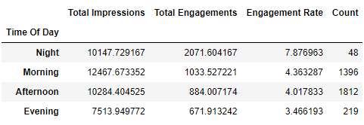
Questions - Day and Time of Posting
Does day of the week of posting affect engagement rates?
Posting on Tuesday or Thursday clearly have better engagement rates when compared to posting on Wednesday or Saturday.
Does time of posting affect engagement rates?
Posting at Night (from midnight to 6am) has a significantly higher engagement rate (7.87) than any other time of the day.

Slide 8
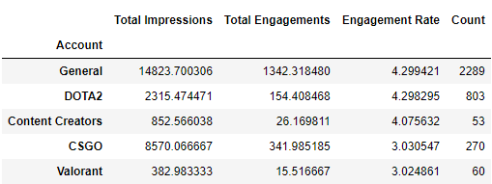
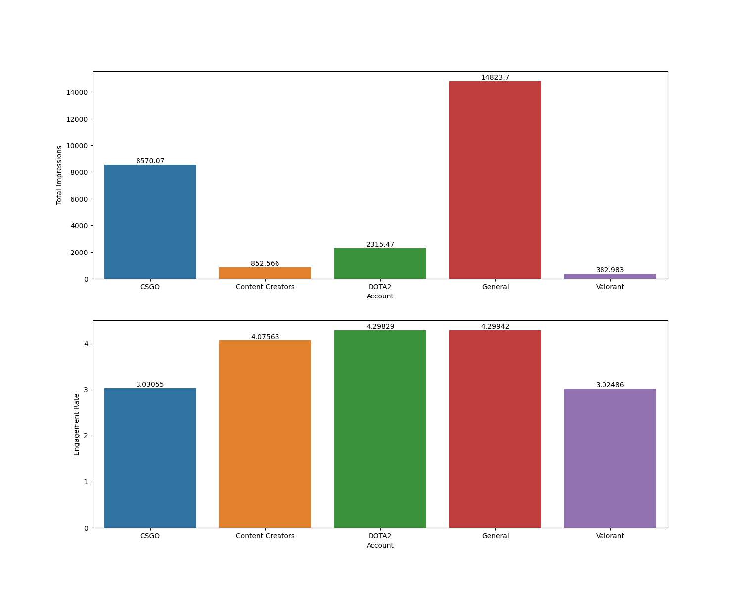
Questions - Game Types
How are game titles doing in terms of social performance? Specific game to focus on?
Highest impressions and engagement rate (4.299%) is maintained by ‘General’ posts.
Even though ‘CSGO’ has a higher average impression count with fewer posts, the ‘DOTA2’ account is doing better with an engagement rate of 4.298%.
Focusing on ‘Content Creators’ could also help increase engagement as it ranks third after ‘General’ and ‘DOTA2’ tags but has fewer samples.

Slide 9
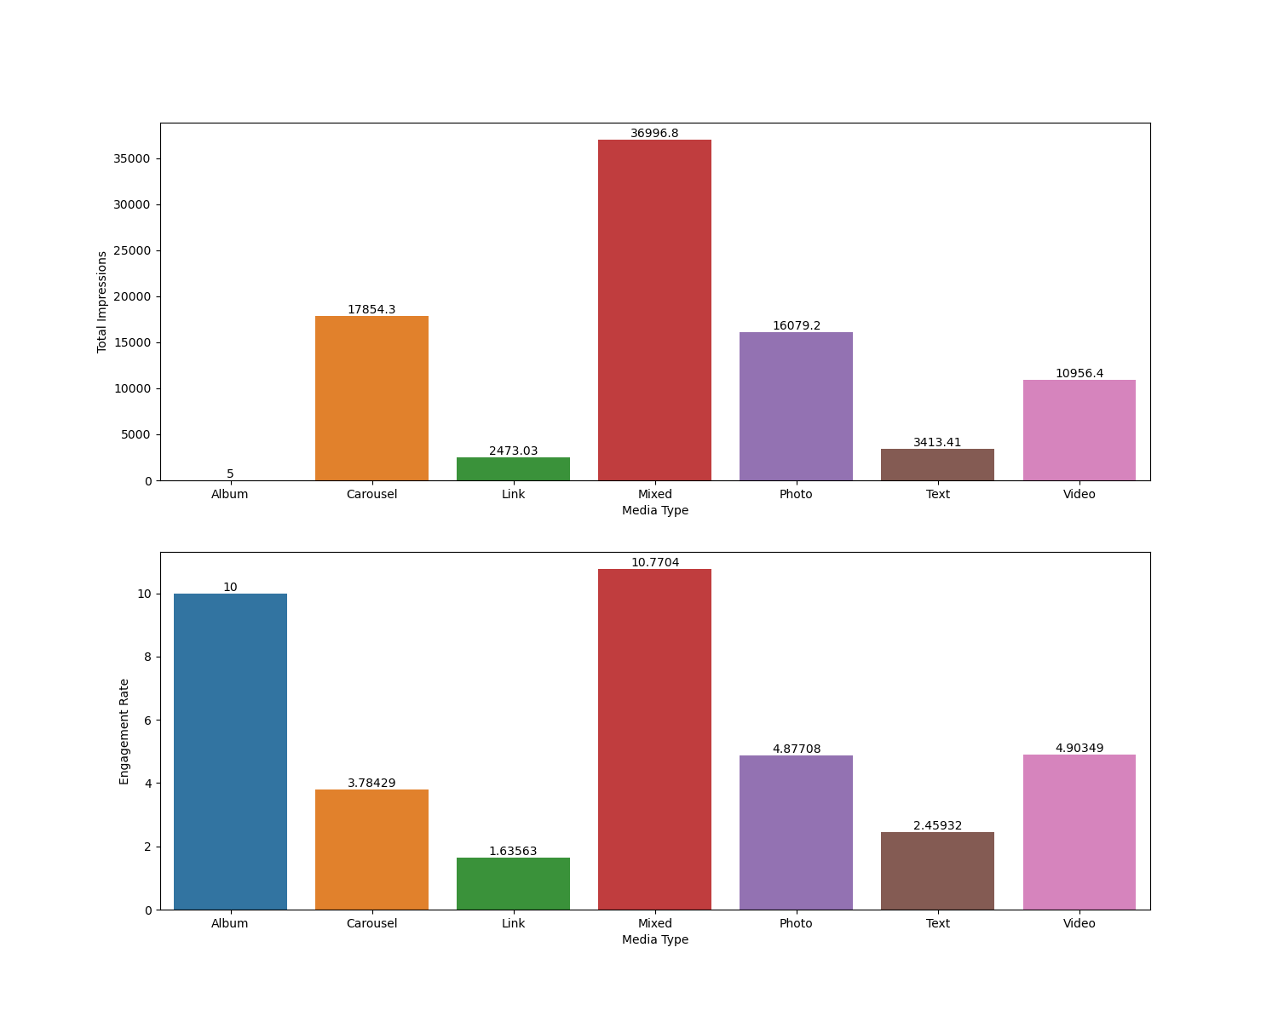
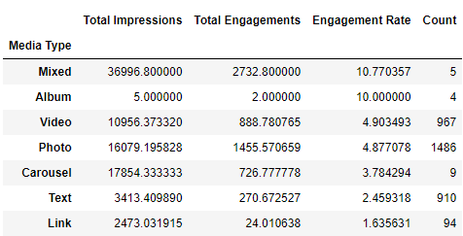
Questions - Media Types
What media type performs the best?
Posts with ‘Mixed’ form of media has performed the best with an engagement rate of 10.77%. (Note that the number of samples are very few to make any sort of concrete conclusion.)
‘Video’ and ‘Photo’ forms of media follow with an engagement rate of around 4.903 & 4.877 respectively, with sufficient samples.
‘Album’ hasn’t been considered in the mix due to insufficient number of posts & impressions.

Slide 10
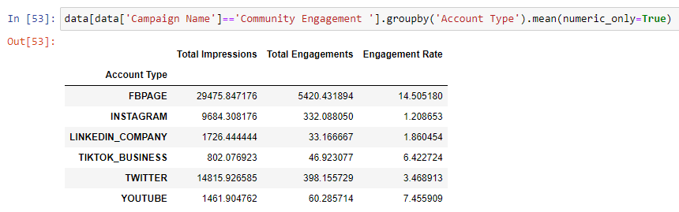
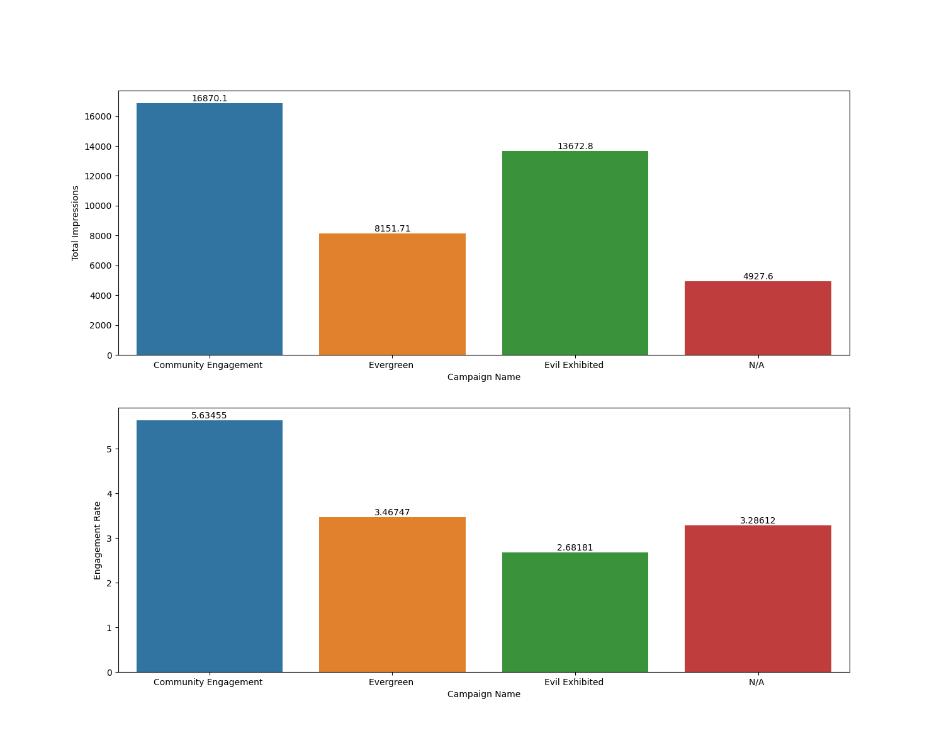
Questions - Campaigns
What is our best performing campaign?
‘Community Engagement’ campaigns have been the most successful, grossing an engagement rate of 5.63% as well as the highest number of impressions on average.
Posts with no campaign have also had a similar, if not better, amount of engagement rate when compared to other EG campaigns.

Slide 11
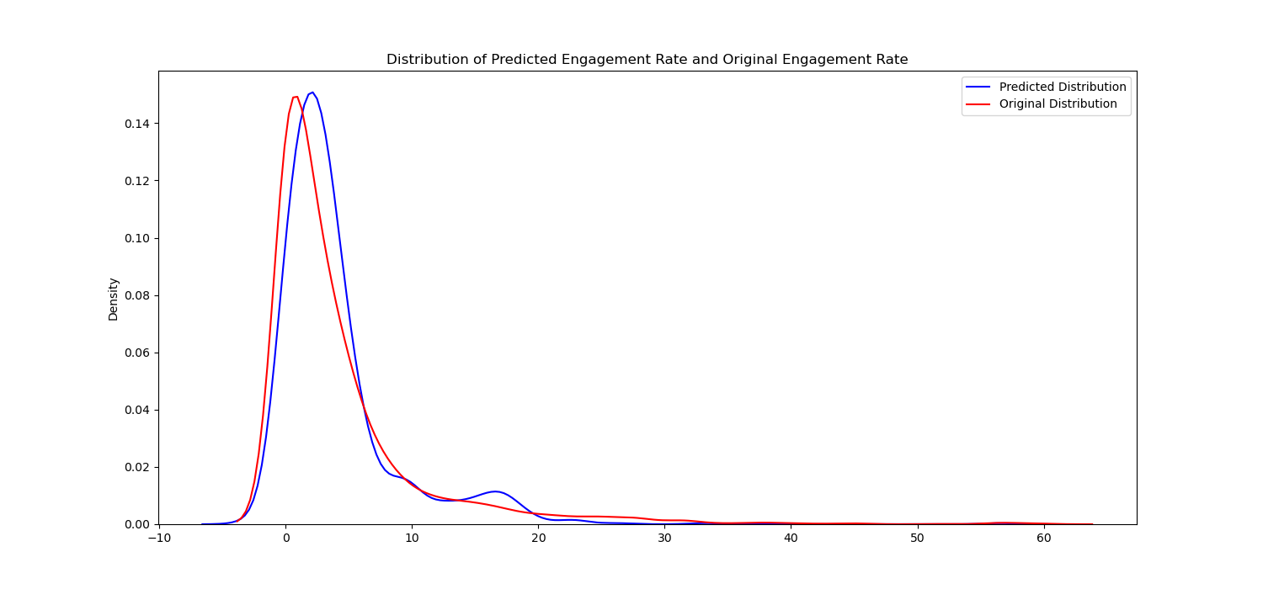
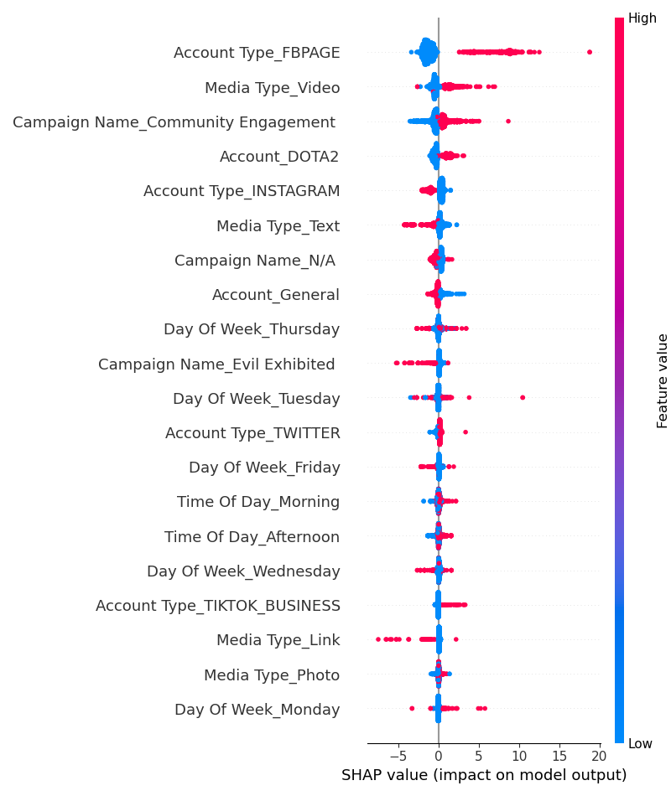
Extra - XGBoost & SHAP
Developed an XGBoost Regression model with Engagement Rate as the target variable to understand the impact of features on it.
Distribution of predicted & original engagement rate is similar with an RMSE of 5.42, which can be improved, but our primary aim is to understand how features interact with the target variable.
Video, Community Engagement & DOTA2 positively affect the rate which corroborates our analyses.
Model gives insight in Account Type variable, where posting on Facebook has a positive impact on the engagement rate contrary to posting on Instagram.

Slide 12
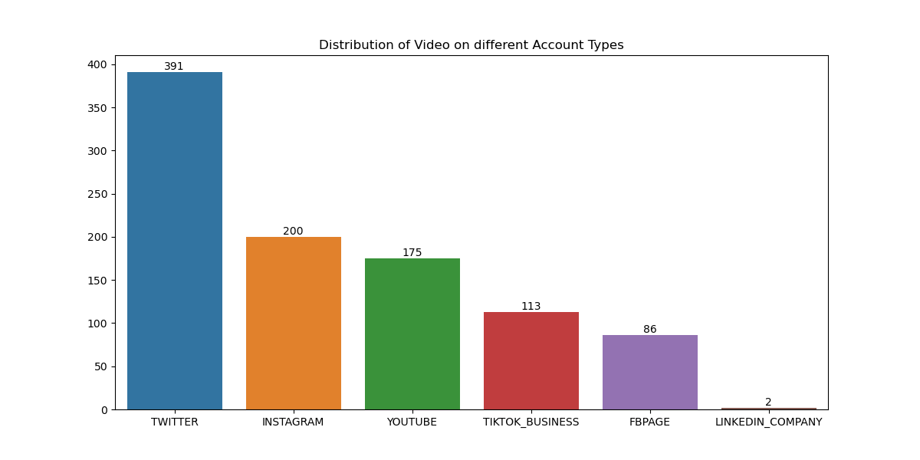
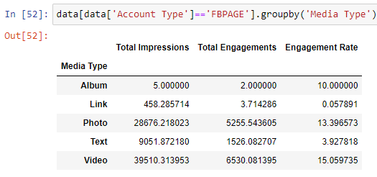
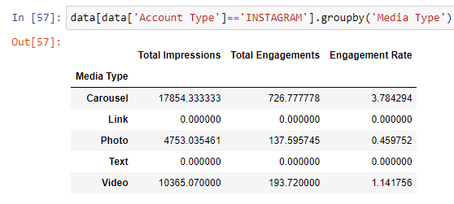
Extra(contd.) - Account Type
Photos and Videos on Facebook have a considerably better engagement rate than Instagram.
However, number of videos posted on Instagram (200) is higher than Facebook (86).
Facebook algorithm might be better at sharing EG’s content.

Slide 13
Posting Strategy & Suggestions
All the Social Channels should preferably post in mornings (for higher impressions) or nights (for higher engagement rate) on Tuesdays or Thursdays focusing on Community Engagement and/or DOTA 2 content consisting of Videos and Photos posting on Facebook, Tiktok or Youtube.
Using the analysis gathered from the model, I would like to suggest the EG social media team to post more Videos and Photos on Facebook.
One of my other suggestions would be to expand towards the content creators front through Youtube or any other streaming platform, since the data shows a higher engagement rate of 4.07% with a max of 37.93%.
Another suggestion for the team would be to not lose hope with the Valorant content due to recent qualification of EG’s Valorant team to Masters Tokyo.
“Correlation is not causation” should be kept in mind!

Slide 14
Questions?

